Slide 1

DS-GA 1011 Fall 2017
Lab 5
Word Embedding & Analogy Evaluation
Artie Shen | Center Data Science

Slide 2
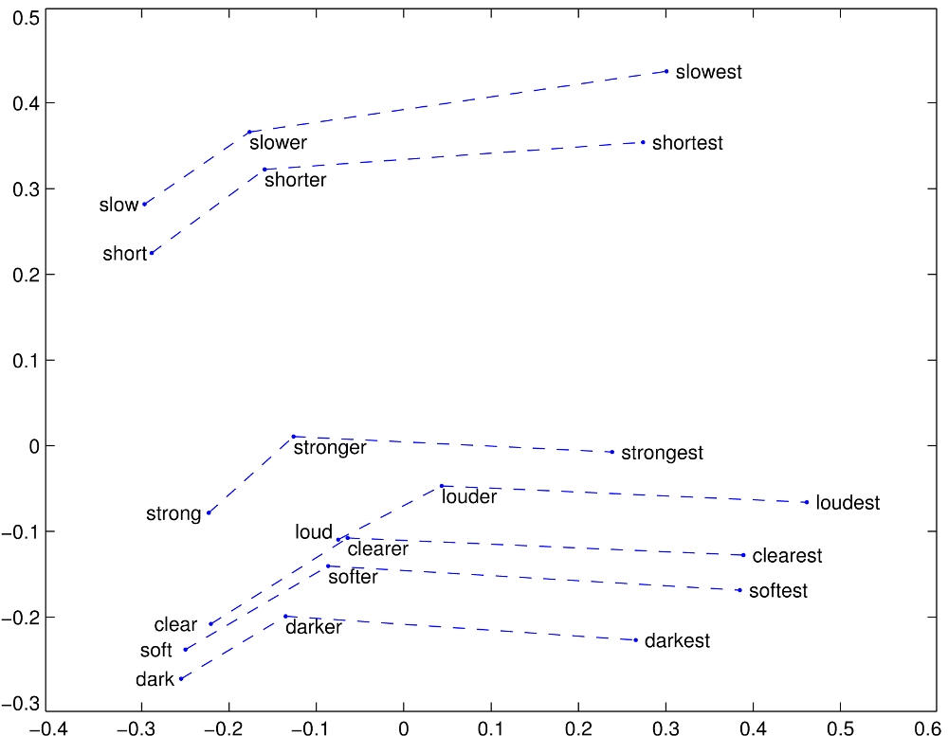
Word Embedding
Word -> Vector
Relationships among vectors can represent relationships among words
Reference: GloVe: Global Vectors for Word Representation, Jeffrey Pennington, Richard Socher, Christopher D. Manning, https://nlp.stanford.edu/projects/glove/

Slide 3
Word Embedding
Why word embedding?
Find the animals in:
  Mat, Fat, Cat, Bat, Eat, Hat
Models that generate word embedding
  Word2Vec
  GloVe (HW02)

Slide 4
Word Analogy
A to B = C to D
Given A, B, and C, find best match for D
Examples:
  Athens to Greece = Berlin to ?
  King to Men = Queen to ?
  Dark to Darker = Soft to ?
  Flock to Bird = School to ?

Slide 5
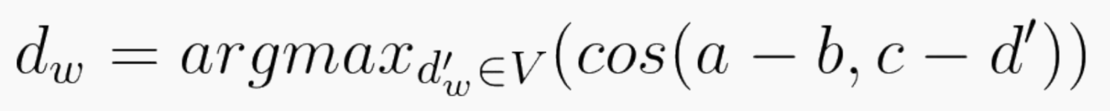
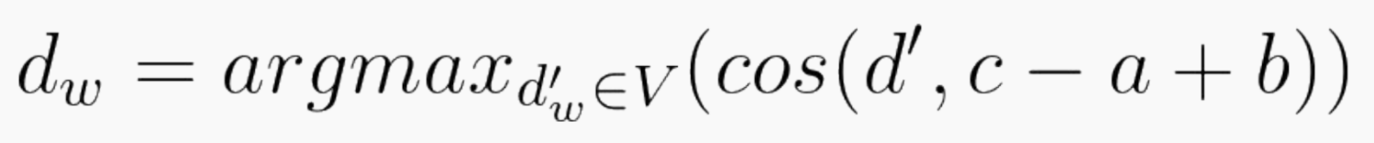
Word Analogy
Use word embedding to solve word analogy problem
  Input a, b, c
  Find d that matches a to b is c to d
  Find the embedding vectors for a, b, and c
Two ways to formulate the problem
Common Trick: don’t allow words a, b, c to be the answer

Slide 6
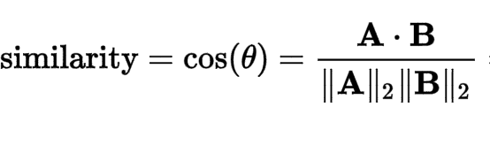
Similarity Measure
sim: (R^d, R^d) -> R
Measure the angle between two vectors
Range: [-1, 1]
  -1 when two vectors point to exactly opposite direction
  1 when two vectors point to the same direction

Slide 7


